Slide 1
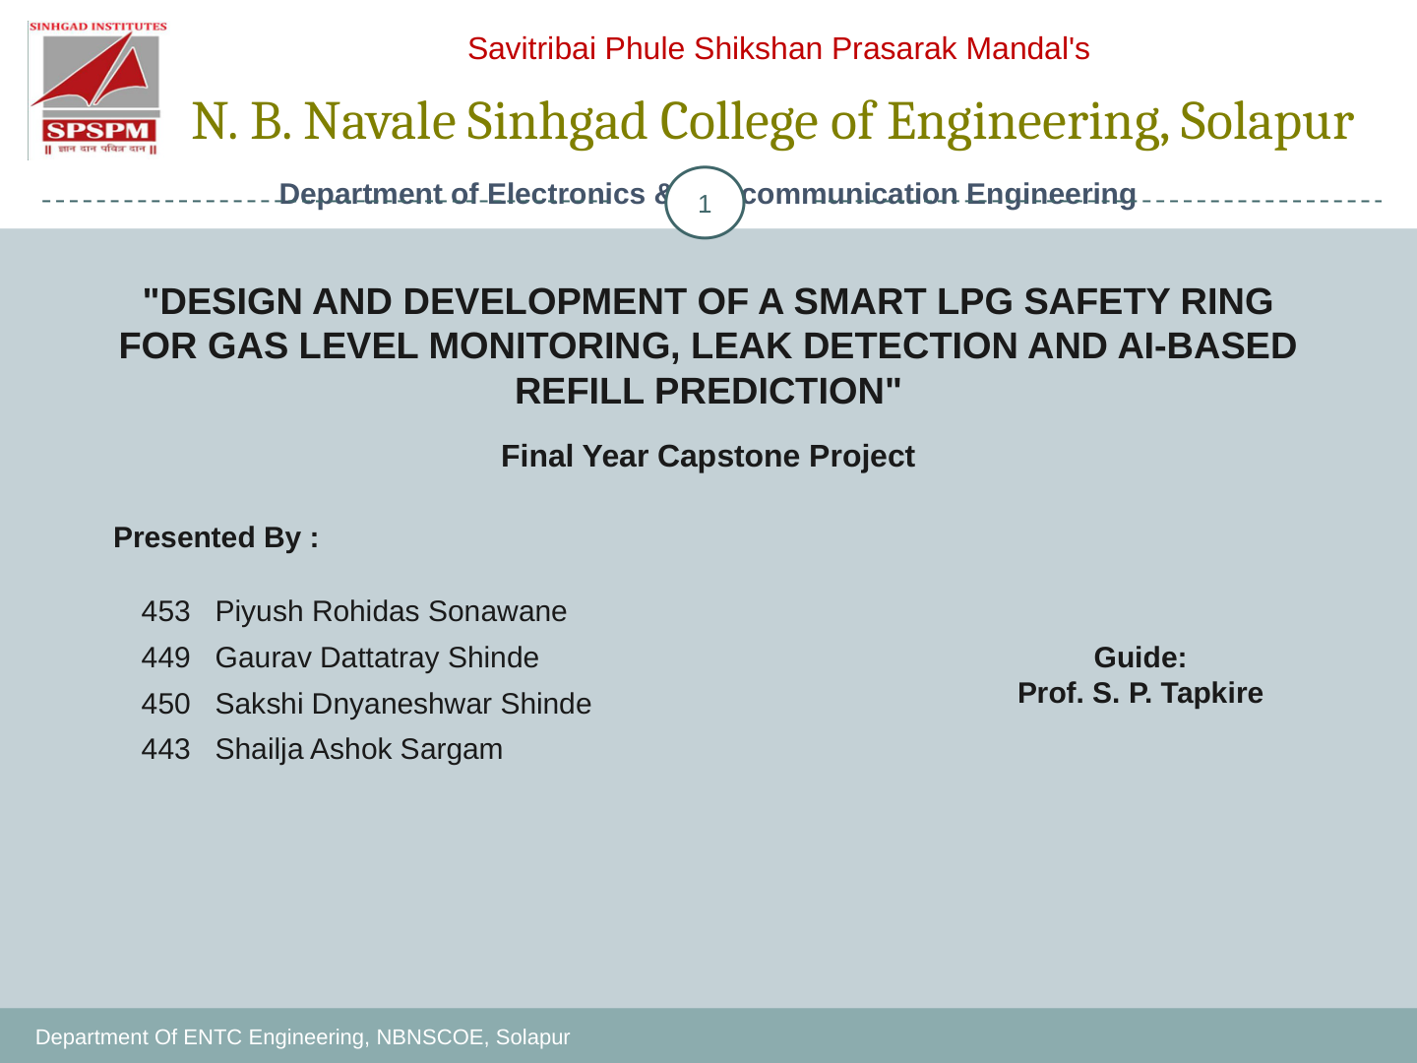
DESIGN AND DEVELOPMENT OF A SMART LPG SAFETY RING
FOR GAS LEVEL MONITORING, LEAK DETECTION AND AI-BASED REFILL PREDICTION
Final Year Capstone Project | Research-Paper-Based Presentation
Presented by:
Piyush Rohidas Sonawane (453)
Gaurav Dattatray Shinde (449)
Sakshi Dnyaneshwar Shinde (450)
Shailaja Ashok Sargam (443)
Project Guide:
Prof. S. P. Tapkire
Department of Electronics & Telecommunication Engineering • N. B. Navale Sinhgad College of Engineering, Solapur

Slide 2
Savitribai Phule Shikshan Prasarak Mandal's | N. B. Navale Sinhgad College of Engineering, Solapur
Contents
2
Introduction and problem statement
Objectives and literature survey
System architecture and ring mechanical design
Hardware components and sensing principles
Firmware workflow and cloud/mobile application
Weight calibration, remaining-gas estimation and refill prediction
Experimental methodology and evidence available
Safety, limitations, future scope and conclusion
References
Department of Electronics & Telecommunication Engineering • NBNSCOE, Solapur

Slide 3
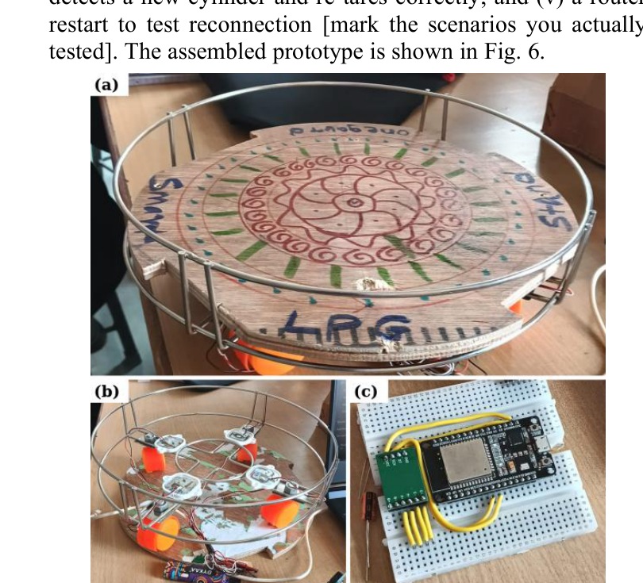
Savitribai Phule Shikshan Prasarak Mandal's | N. B. Navale Sinhgad College of Engineering, Solapur
Introduction
3
LPG is widely used in Indian homes, restaurants, hostels and community kitchens.
Two practical issues motivate this project: an unnoticed leak and uncertainty about the remaining gas.
OneGuard combines a cylinder-support ring, gas sensing, weight measurement and remote monitoring.
The proposed system is a retrofit design intended to avoid modifying the cylinder, regulator or pipeline.
It provides an additional layer of warning; it does not replace approved LPG safety practices.
Prototype images reproduced from the supplied research paper, Fig. 6.
Department of Electronics & Telecommunication Engineering • NBNSCOE, Solapur

Slide 4
Savitribai Phule Shikshan Prasarak Mandal's | N. B. Navale Sinhgad College of Engineering, Solapur
Problem Statement & Objectives
4
Problem: conventional alarms often report leakage only; they may not report remaining fuel quantity.
Measure cylinder mass using load cells and an HX711 amplifier, then calculate net LPG after tare correction.
Detect suspected leakage with an MQ-series sensor and activate a local buzzer/LED.
Send current readings and alert events to a mobile dashboard through Wi-Fi/cloud services.
Use historical consumption to estimate remaining days and provide early refill reminders.
Explore backup power and alternate communication for resilience.
Department of Electronics & Telecommunication Engineering • NBNSCOE, Solapur

Slide 5
Savitribai Phule Shikshan Prasarak Mandal's | N. B. Navale Sinhgad College of Engineering, Solapur
Literature Survey & Research Gap
5
Gas alarms using semiconductor sensors and buzzers provide low-cost local warnings, but often omit fuel-level tracking.
IoT-based systems add cloud dashboards and remote notifications; many remain focused mainly on leakage.
Load-cell + HX711 approaches estimate cylinder contents from total mass minus cylinder tare.
The research paper identifies an integration gap: leak detection, weight-based level estimation and environmental sensing are rarely combined in one low-cost retrofit unit.
Literature citations in the supplied documents should be verified against the original publisher records before final academic submission.
Department of Electronics & Telecommunication Engineering • NBNSCOE, Solapur

Slide 6
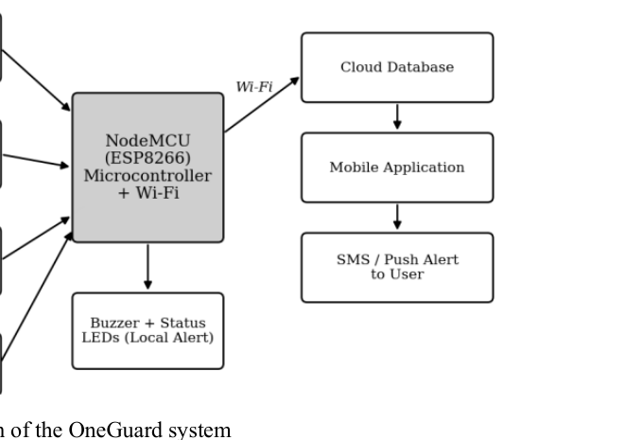
Savitribai Phule Shikshan Prasarak Mandal's | N. B. Navale Sinhgad College of Engineering, Solapur
System Block Diagram
6
Load cells + HX711: measure cylinder/platform mass.
MQ-series gas sensor: provides a raw signal used by leak-detection logic.
DHT22 (as proposed in the paper): records ambient temperature and humidity.
ESP-class controller: filters sensor readings, checks leak state and drives the local alarm.
Wi-Fi/cloud/mobile app: carries readings, history and remote notifications.
Important: the research paper describes NodeMCU ESP8266; the current project hardware discussions use ESP32. Final diagrams and firmware must match the board actually installed.
Source: supplied research paper, Fig. 1 (block diagram).
Department of Electronics & Telecommunication Engineering • NBNSCOE, Solapur

Slide 7
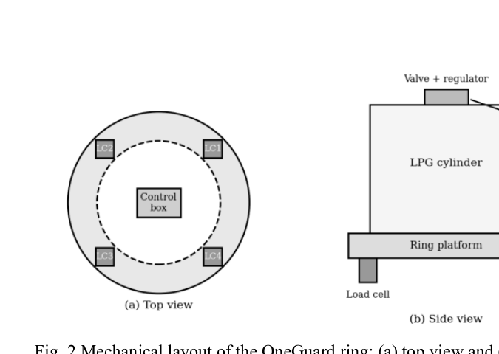
Savitribai Phule Shikshan Prasarak Mandal's | N. B. Navale Sinhgad College of Engineering, Solapur
Ring Mechanical Design
7
The cylinder rests on a ring-shaped platform; the design is intended to preserve the normal cylinder connection.
Load cells are distributed beneath the platform to share load and reduce sensitivity to cylinder position.
The control enclosure should be mounted securely away from the valve/regulator area.
Non-slip support and mechanical alignment matter because off-centre loading can change readings.
Final dimensions, material, load-cell count and rated capacity must be documented from the actual build.
Source: supplied research paper, Fig. 2 (mechanical layout).
Department of Electronics & Telecommunication Engineering • NBNSCOE, Solapur

Slide 8
Savitribai Phule Shikshan Prasarak Mandal's | N. B. Navale Sinhgad College of Engineering, Solapur
Hardware Components
8
ESP32 / NodeMCU: embedded processing and Wi-Fi (confirm the final board).
MQ-6 gas sensor module: LPG-oriented combustible-gas sensing; needs warm-up and calibration.
Load cells + HX711: weight measurement through a strain-gauge bridge and 24-bit ADC.
DHT22: temperature and humidity sensing, proposed for environmental logging/compensation.
Buzzer + status LEDs: immediate local warning and device-state indication.
Power supply; proposed future additions include battery backup, optional OLED and GSM fallback.
Department of Electronics & Telecommunication Engineering • NBNSCOE, Solapur

Slide 9
Savitribai Phule Shikshan Prasarak Mandal's | N. B. Navale Sinhgad College of Engineering, Solapur
Sensing Principles & Key Calculations
9
Load-cell calibration: W = (N − N₀) / k, where N is the measured count, N₀ is the zero offset and k is the calibrated scale factor.
Net gas mass: Wgas = Wtotal − Wtare. The platform must be tared separately, and cylinder tare must be subtracted for a real cylinder.
Gas remaining (%): (Wgas / configured full net content) × 100, clamped to 0–100%.
Remaining days: estimated gas mass divided by a moving-average daily consumption rate; show no estimate until enough history exists.
MQ sensing: raw ADC/voltage is not automatically ppm. A valid ppm estimate needs the exact sensor, load resistance, clean-air baseline and datasheet calibration.
Department of Electronics & Telecommunication Engineering • NBNSCOE, Solapur

Slide 10
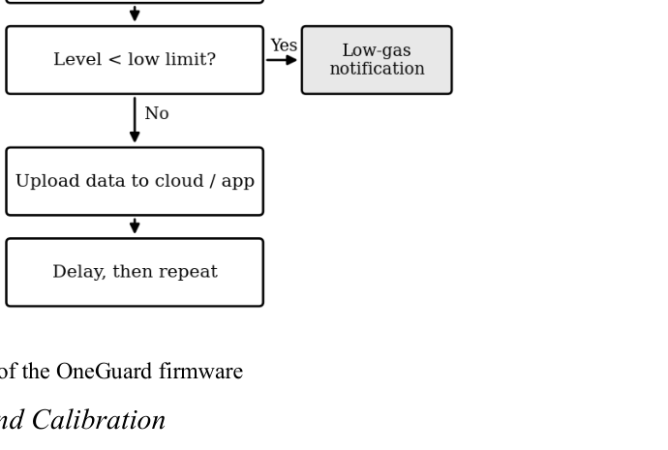
Savitribai Phule Shikshan Prasarak Mandal's | N. B. Navale Sinhgad College of Engineering, Solapur
Firmware Workflow
10
1. Initialize controller and sensors; establish safe output state.
2. Warm up the gas sensor and validate sensor readings.
3. Read and filter gas and load-cell data.
4. Evaluate leak/fault logic first and activate local alarm without waiting for Wi-Fi.
5. Calculate gas quantity and update consumption history.
6. Upload timestamped telemetry when connected; queue or retry after network loss where supported.
7. App marks data stale/offline when heartbeats stop; it must never treat old data as live.
Source: supplied research paper, Fig. 3 (firmware flowchart).
Department of Electronics & Telecommunication Engineering • NBNSCOE, Solapur

Slide 11
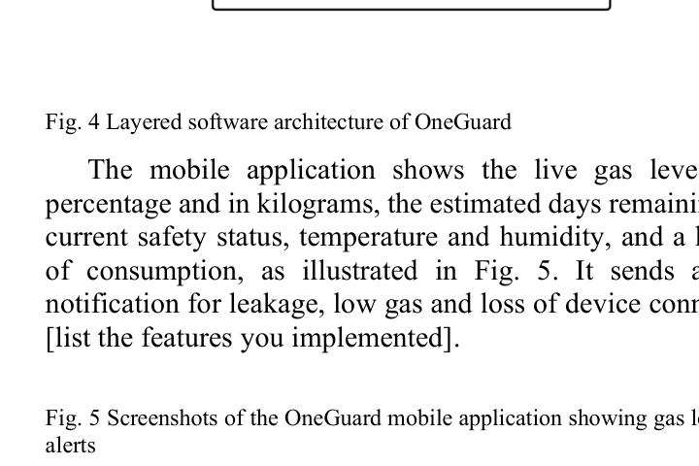
Savitribai Phule Shikshan Prasarak Mandal's | N. B. Navale Sinhgad College of Engineering, Solapur
Cloud Architecture & Mobile Application
11
Device → authenticated API/cloud → live state + event history → authenticated user dashboard.
Firebase Authentication can isolate each user's devices and records by UID.
Realtime Database suits latest readings; Firestore can hold device metadata, durable events and alert-delivery records.
Dashboard: safety state, last-seen time, gas raw reading, gas mass/percentage, history and refill estimate.
Alerts: local buzzer/LED first; push/SMS/voice are optional remote channels and depend on connectivity/provider setup.
Security: device credentials map to an owner server-side; never accept an arbitrary owner UID from device payloads.
Source: supplied research paper, Fig. 4 (layered software architecture).
Department of Electronics & Telecommunication Engineering • NBNSCOE, Solapur

Slide 12
Savitribai Phule Shikshan Prasarak Mandal's | N. B. Navale Sinhgad College of Engineering, Solapur
Experimental Methodology & Results
12
Planned / required tests
Evidence status in supplied paper
Weight calibration using known reference masses at several positions.
Record absolute error, percentage error and repeatability.
Measure local alarm and app notification latency in a controlled, reviewed test.
Test hotspot/router loss, reconnection and stale-data detection.
Check false alarms, sensor warm-up/drift and power consumption.
The research paper contains placeholders for key measurements, including leak response time, weight error, prototype cost, trials and power draw.
No measured values have been filled in the provided document. This presentation therefore does not invent performance results. Complete the test tables from actual experiments before presenting quantitative claims.
Safety: do not release LPG for an uncontrolled test; use safe, controlled methods and qualified supervision.
Department of Electronics & Telecommunication Engineering • NBNSCOE, Solapur

Slide 13
Savitribai Phule Shikshan Prasarak Mandal's | N. B. Navale Sinhgad College of Engineering, Solapur
Safety, Limitations & Future Scope
13
Safety: local detection and alarm must work when Wi-Fi/cloud is unavailable; sensor fault must never be shown as safe.
MQ metal-oxide sensors can respond to other vapours and drift with time, humidity and temperature.
Weight accuracy depends on calibration, stable mechanics, load distribution and correct cylinder tare.
Remote alerting depends on network and provider availability; SMS/voice may incur charges.
Future work: validated automatic shut-off hardware, better LPG selectivity, battery backup, GSM fallback, custom PCB/enclosure and field validation/certification.
Prototype status: additional protection only—not a certified gas alarm or replacement for approved LPG safety procedures.
Department of Electronics & Telecommunication Engineering • NBNSCOE, Solapur

Slide 14
Savitribai Phule Shikshan Prasarak Mandal's | N. B. Navale Sinhgad College of Engineering, Solapur
Conclusion
14
OneGuard integrates three useful functions: LPG leak sensing, weight-based remaining-gas estimation and remote monitoring.
The ring form aims to make installation simple without changing the cylinder connection.
The core engineering priorities are reliable calibration, low false-alarm rate, secure data ownership and offline local response.
AI-based refill prediction should be introduced only after enough trustworthy consumption history is collected and evaluated.
Next step: complete wiring and calibration records, fill experimental result tables, verify references and conduct end-to-end tests.
Prototype photographs from the supplied research paper; quantitative validation remains to be completed.
Department of Electronics & Telecommunication Engineering • NBNSCOE, Solapur

Slide 15
Savitribai Phule Shikshan Prasarak Mandal's | N. B. Navale Sinhgad College of Engineering, Solapur
References
15
[1] MQ-6 Semiconductor Sensor for LPG Data Sheet, Hanwei Electronics Co., Ltd. (as cited in supplied paper).
[2] HX711 24-Bit Analog-to-Digital Converter for Weigh Scales Data Sheet, Avia Semiconductor (as cited in supplied paper).
[3] DHT22 (AM2302) Digital Temperature and Humidity Sensor Data Sheet, Aosong Electronics (as cited in supplied paper).
[4] ESP8266EX Datasheet, Espressif Systems (as cited in supplied paper).
[5] N. Manjunathan, S. Muthulingam, D. Jaganathan, “IoT Based Gas Leakage Detection System,” ICSCDS-2023, IEEE Xplore (listed in supplied presentation; verify bibliographic details).
[6] Additional literature references in the supplied documents include IoT gas leakage detection, intelligent LPG regulator monitoring, and explainable ML for LPG refill frequency; verify exact publication metadata before submission.
Department of Electronics & Telecommunication Engineering • NBNSCOE, Solapur

Slide 16
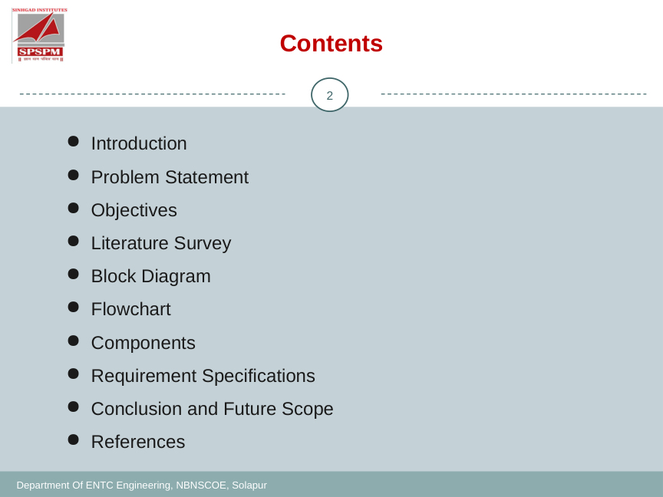
Thank You
Questions & Discussion
OneGuard — Smart LPG Safety Ring | NBNSCOE, Solapur

Slide 17
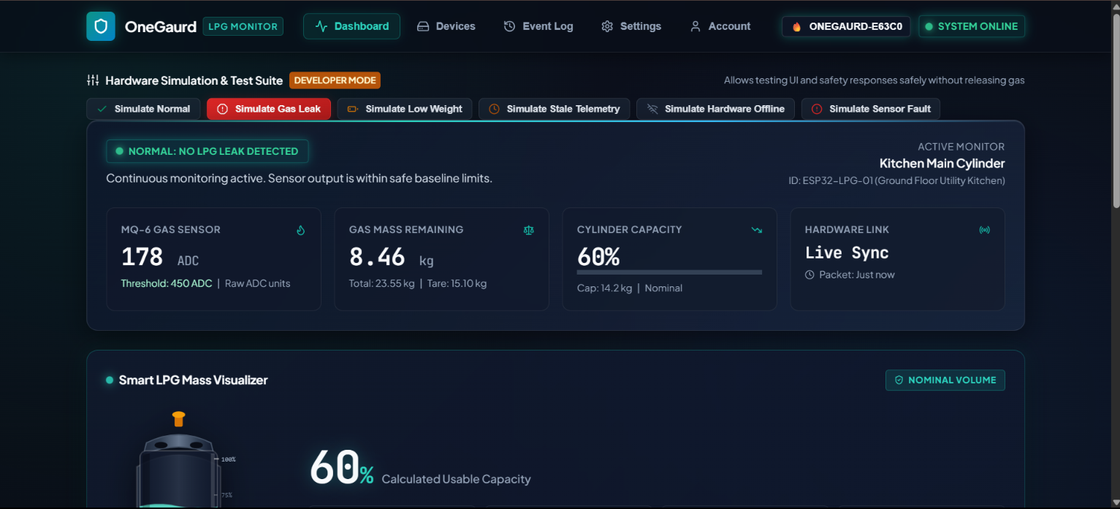
ONEGUARD | SMART LPG SAFETY RING
Live Dashboard — UI Design Reference
Dashboard screenshot supplied by the project team. Values shown are UI/demo values, not validated sensor results.
17

Slide 18
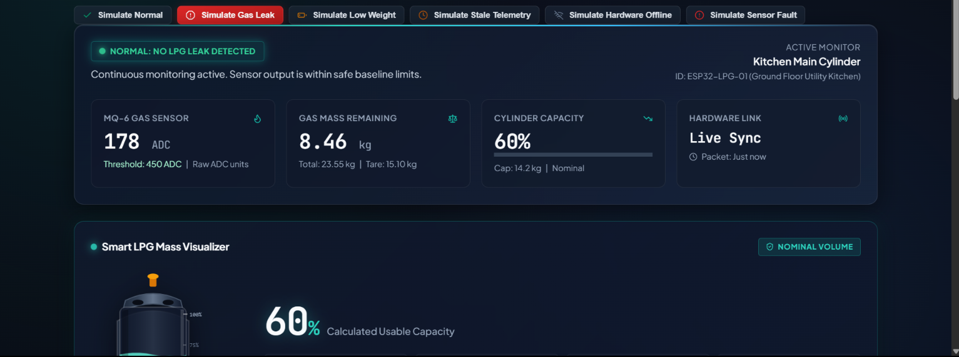
ONEGUARD | SMART LPG SAFETY RING
Dashboard Analysis — Readings, States & Visual Checks
Review findings
01
Reading consistency
8.46 kg remaining ÷ 14.2 kg capacity ≈ 59.6%, consistent with the displayed 60%.
02
Tare arithmetic
23.55 kg gross − 15.10 kg tare = 8.45 kg. The dashboard also shows 8.46 kg; reconcile rounding/source values.
03
Threshold state
178 ADC is below the shown 450 ADC threshold, consistent with the normal state if the threshold logic is defined that way.
04
Safety labeling
ADC is a raw sensor unit, not ppm. Mark readings as demo/simulated until calibrated and live telemetry is verified.
18

Slide 19
ONEGUARD | SMART LPG SAFETY RING
Presentation Motion & Final Visual QA
Recommended transitions
Visual QA checks
• Use a subtle Fade transition between technical slides.
✓ Dashboard screenshot added without stretching.
• Use Morph only for a sequence that intentionally zooms from architecture → hardware → dashboard.
✓ Raw ADC is not presented as gas concentration in ppm.
✓ Gross − tare arithmetic discrepancy is explicitly flagged.
• Keep transitions around 0.4–0.6 seconds; avoid flashy effects on safety content.
✓ Experimental performance claims remain unfilled until measured.
• Animate diagrams in reading order only when it improves explanation.
✓ Local ESP32 safety response must not depend on cloud connectivity.
19

